Slide 1
Sentiment speech analyser
Author: Bhavin
User Manual
Notes:
Preworks course home assignments

Slide 2

Table of Contents
Acknowledgements
About Me
My journey with clevered
About App
Thank you
How to use the App

Slide 3
About Me..
Hello everyone Good evening, my name is Bhavin, I am 13 years old and I am from Andhra Pradesh,India.
I current live in Abu Dhabi,Uae and study in year 9
My hobbies are playing video games with my friends,Football, skateboarding, reading books and ofcourse Coding

Slide 4
Acknowledgements
Throughout My journey with the internship I have learnt a lot and this is because of our wonderful teacher Mr Avishek, Mr Avishek has always been very patient with me and always guided me on the correct path. I would also like to Thank Dr.Ken and Ms.Shivani for their amazing feedback and insight on my work.

Slide 5
About My Journey with Clevered..
I have been with clevered for more than a year now, I have completed lots of courses with the help of the amazing teachers and staff available to me.
I have learned a lot with clevered and I hope to continue my journey with clevered in the future

Slide 6
About Application
My application is a speech sentiment analyser. Which simply means that when a person enters a text it will show if the text is positive negative or neutral. It also shows the percentage in which it is neutral positive or negative.

Slide 7

Why I made this application
Sentiment analysis can further develop customer loyalty and maintenance through better assistance results and customer experience. Which can help many businesses on their reviews of products etc.

Slide 8
How do I use the App?
To use the App it is very simple all you have to do is enter a speech in the text box given and make sure it includes some sort of emotion and then just click the check sentiment button it will then show you if the speech you have entered is positive neutral or negative and it also shows the perecentage.

Slide 9
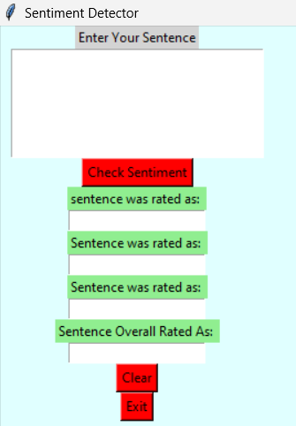
The app
This is my app,
Firstly you have to type any text which includes a type of emotion.
Anything is allowed here as long as you include a sentence with a proper emotion keyword e.g.(Happy,Sad,Excited etc.)

Slide 10
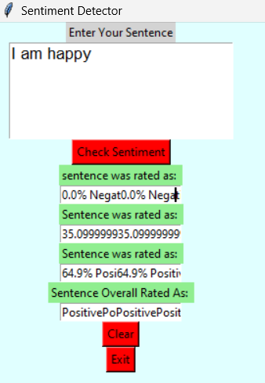
Second step
After you have your text you should simply just click the check sentiment button and it will show you if your text is positive or negative and the percentage of either

Slide 11
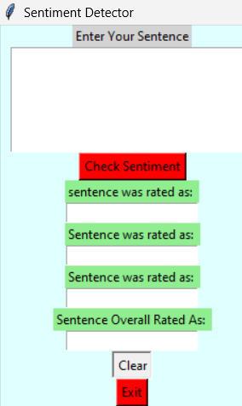
Third
If you want to remove the text all you have to do is click the clear button to remove all the text previously written to write a new one with a different emotion

Slide 12
Thank you

